Slide 1
Review 2.3
B.Tech Project (19ECE495)
Batch ID: 041
Multi-Class Classification and Detection of Knee Osteoarthritis From X- rays
MENTOR: Dr. Devi Vijayan
Dept. of Elec. and Commn. Engg.
Amrita School of Engineering, Coimbatore
CB.EN.U4ECE21008 | - | C RISHI VARDHAN REDDY
CB.EN.U4ECE21011 | - | D M SHAAHID
CB.EN.U4ECE21012 | - | DULAM SANTHOSH
CB.EN.U4ECE21033 | - | NUKALA SUMANTH

Slide 2
Introduction:
Knee osteoarthritis (KOA) is a common joint disorder characterized by the gradual degeneration of cartilage and underlying bone in the knee joint, leading to pain, stiffness, and reduced mobility.
KOA affects approximately 1 in 5 individuals in the general population and 1 in 3 people over the age of 50 [1], making it a significant contributor to impaired quality of life and daily functioning.
Early detection and accurate classification of KOA severity are critical for effective treatment, as timely interventions can prevent further joint damage and improve patient outcomes.
Current diagnostic methods, such as physical exams and X-ray imaging, are often subjective and may misclassify early stages of KOA, leading to delayed or inappropriate treatment.

Slide 3
Objective:
Validate the model's predictions using test data to assess its accuracy and Precision.
Compare the model's performance with existing state-of-the-art models.
Employ deep learning model to automatically categorize the severity of knee osteoarthritis into five grades (G-0 to G-4) based on the Kellgren and Lawrence classification system.

Slide 4
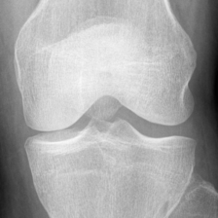
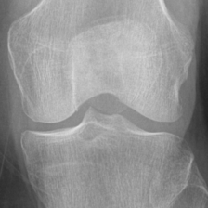
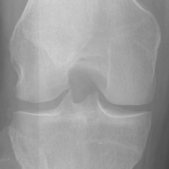
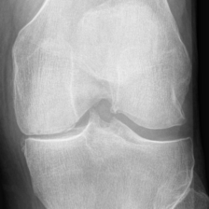
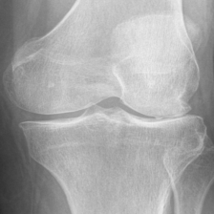
Data Preparation:
Dataset[2]:
The dataset used in the study is based on the Osteoarthritis Initiative (OAI) dataset.
The dataset contains 8,260 X-ray images of knee joints, graded according to the Kellgren-Lawrence (KL) grading scheme. The distribution of the dataset across KL grades is as follows:
  Grade 0: 3,253 images
  Grade 1: 1,495 images
  Grade 2: 2,175 images
  Grade 3: 1,086 images
  Grade 4: 251 images
Grade0 Grade1 Grade2 Grade3 Garde4

Slide 5
Data Distribution
 | GRADE 0 | GRADE 1 | GRADE 2 | GRADE 3 | GRADE 4
TEST | 639 | 296 | 447 | 223 | 51
TRAIN | 2286 | 1046 | 1516 | 757 | 173
EVALUATION | 328 | 153 | 212 | 106 | 27
TOTAL | 3253 | 1495 | 2175 | 1086 | 251
• The image dimensions are 224x224 pixels.

Slide 6
Multi-Class Single Level
Test Dataset
CNN
GRADE 0
GRADE 1
GRADE 2
GRADE 3
GRADE 4

Slide 7
PERFORMANCE COMPARISON OF SINGLE LEVEL MODELS
Model | Accuracy | Precision | F1-Score
VGG 16 | 63.77 | 61.83 | 60.64
ResNet50 | 59.36 | 63.59 | 60.92
EfficientNet | 62.86 | 62.49 | 61.21
HRNet | 64.73 | 65.05 | 64.49
ConvNeXt | 71.26 | 71.56 | 69.38

Slide 8
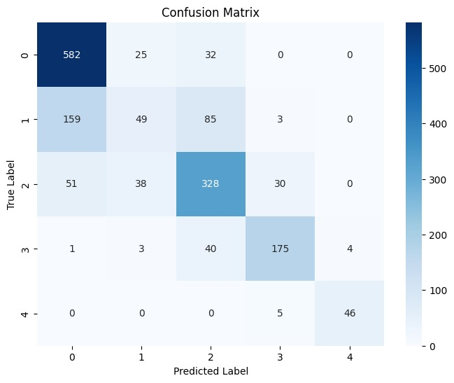
ConvNeXt Model
Class | Recall | Precision
Grade 0(Normal) | 91.07 | 73.39
Grade 1-4(Abnormal) | 58.80 | 65.00

Slide 9
Multi-Class Multi Level
Test Dataset
ConvNeXt
(Level-1)
Normal
Abnormal
ConvNeXt
(Level-2)
GRADE 0
GRADE 1
GRADE 2
GRADE 3
GRADE 4

Slide 10
Level-1 Binary Class Distribution
 | Normal | Abnormal
TEST | 639 | 1017
TRAIN | 2286 | 3502
EVALUATION | 328 | 498
TOTAL | 3253 | 5017
The Ratio of images between Normal and Abnormal is 1:1.54

Slide 11
Level-1 Model Results
Model | Accuracy | Precision | F1-Score
HRNet | 74.40 | 77.73 | 75.07
ConvNeXt | 80.62 | 80.53 | 84.26

Slide 12
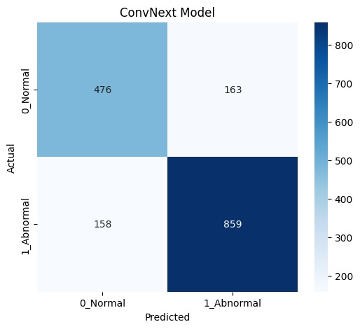
Class | Recall | Precision
Grade 0(Normal) | 74.49 | 75.08
Grade 1-4(Abnormal) | 84.46 | 84.05

Slide 13
Level-2 Abnormal Class Distribution
 | GRADE 1 | GRADE 2 | GRADE 3 | GRADE 4
TEST | 296 | 447 | 223 | 51
TRAIN | 1046 | 1516 | 757 | 173
EVALUATION | 153 | 212 | 106 | 27
TOTAL | 1495 | 2175 | 1086 | 251
• The image dimensions are 224x224 pixels.

Slide 14
Level-2 Model Results
Model | Accuracy | Precision | F1-Score
HRNet(Abnormal) | 69.81 | 70.60 | 69.60
ConvNeXt(Abnormal) | 73.94 | 74.29 | 74.22

Slide 15
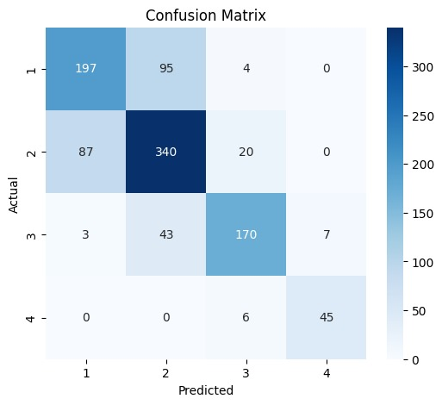
ConvNeXt Model:

Slide 16
Comparison of results
Single Level Model Interpreted in Binary form
Multi Level Model Level-1 results
Class | Recall | Precision
Grade 0(Normal) | 91.07 | 73.39
Grade 1-4(Abnormal) | 58.80 | 65.00
Weighted Average | 71.26 | 71.56
Class | Recall | Precision
Grade 0(Normal) | 74.49 | 75.08
Grade 1-4(Abnormal) | 84.46 | 84.05
Weighted Average | 80.62 | 80.53

Slide 17
Recall Values for Abnormal Classes
Class | Single Level Model | Multi Level Model Level 2
Grade 1 | 16.55 | 66.55
Grade 2 | 73.37 | 76.06
Grade 3 | 78.47 | 76.23
Grade 4 | 90.19 | 88.23
Weighted-Average | 58.80 | 73.94

Slide 18
Timeline:
Review | Month | Milestone
1.1 | Aug 2024 | Data preparation, Data Preprocessing, Literature survey
1.2 | Sep 2024 | Literature survey, Analysis of state-of-the-art models
1.3 | Nov 2024 | Building of classification model
2.1 | Jan 2025 | Validation and performance comparison, Paper draft
2.2 | Mar 2025 | Paper Draft
2.3 | May 2025 (External Review) | Project Report / Dissertation

Slide 19
Deliverables:
Implemented a single level classification model, tested across different models, with ConvNeXt achieving a better performance with an accuracy of 71.26%.
Implemented multi level classification methodology which consists of Binary classification (Level 1) and Abnormal classification (Level 2) with ConvNeXt and HRNet.
ConvNeXt achieved better performance for both level with an accuracy of 80.62% for binary classification and 73.94% for Abnormal classification.

Slide 20
References:
A. Mobasheri, C. S. Thudium, A.-C. Bay-Jensen, T. Maleitzke, S. Geissler, G. N. Duda, and T. Winkler, "Biomarkers for osteoarthritis: Current status and future prospects," Best Practice & Research Clinical Rheumatology, vol. 37, p. 101852, June 2023.
Chen, Pingjun (2018), “Knee Osteoarthritis Severity Grading Dataset”, Mendeley Data, V1. [Online]. Available: https://tinyurl.com/4h7pwaaa. [Accessed Sept. 12, 2024].

Slide 21
Thank You

